Slide 1
Project 01: Facial Analysis for emotion detection
Facial analysis using deep learning has become a powerful tool for a variety of use cases from capturing emotions of customer to screening candidates when applicants are very large in numbers for positions such as sales staffs on supermarket shop floors. Build prototype application for facial emotion detection using deep learning models (webcam video streams are sufficient for this prototype). Ensure that the the application is usable through REST API using Flask-RESTful or a simple web front end using Flask (or Django equivalents instead of Flask), the application should be able to do the following
Analyse facial expression and detect emotions, at least basic four emotions should be detected viz., “happy”, “sad”, “angry”, “nervous”, “neutral”
Ensure that the emotion is captured at least at two frames per second frequency and populated on a database such as mongoDB or mysql (use free DBaaS, such as MongoDB Atlas and Cleaver Cloud for this)
The application should provide Analytical Insights of the video stream analysed such that that this application can be used for guaging customer sentiments or for screening candidates for employment (e.g., screening/shortlisting candidates for customer facing roles such as sales staffs on the floor of a supermarket)
Use data from public domain or create your own from camera feeds, ensure you go through the process of annotating bounding boxes for faces and face landmarks while preparing the data sets

Slide 2
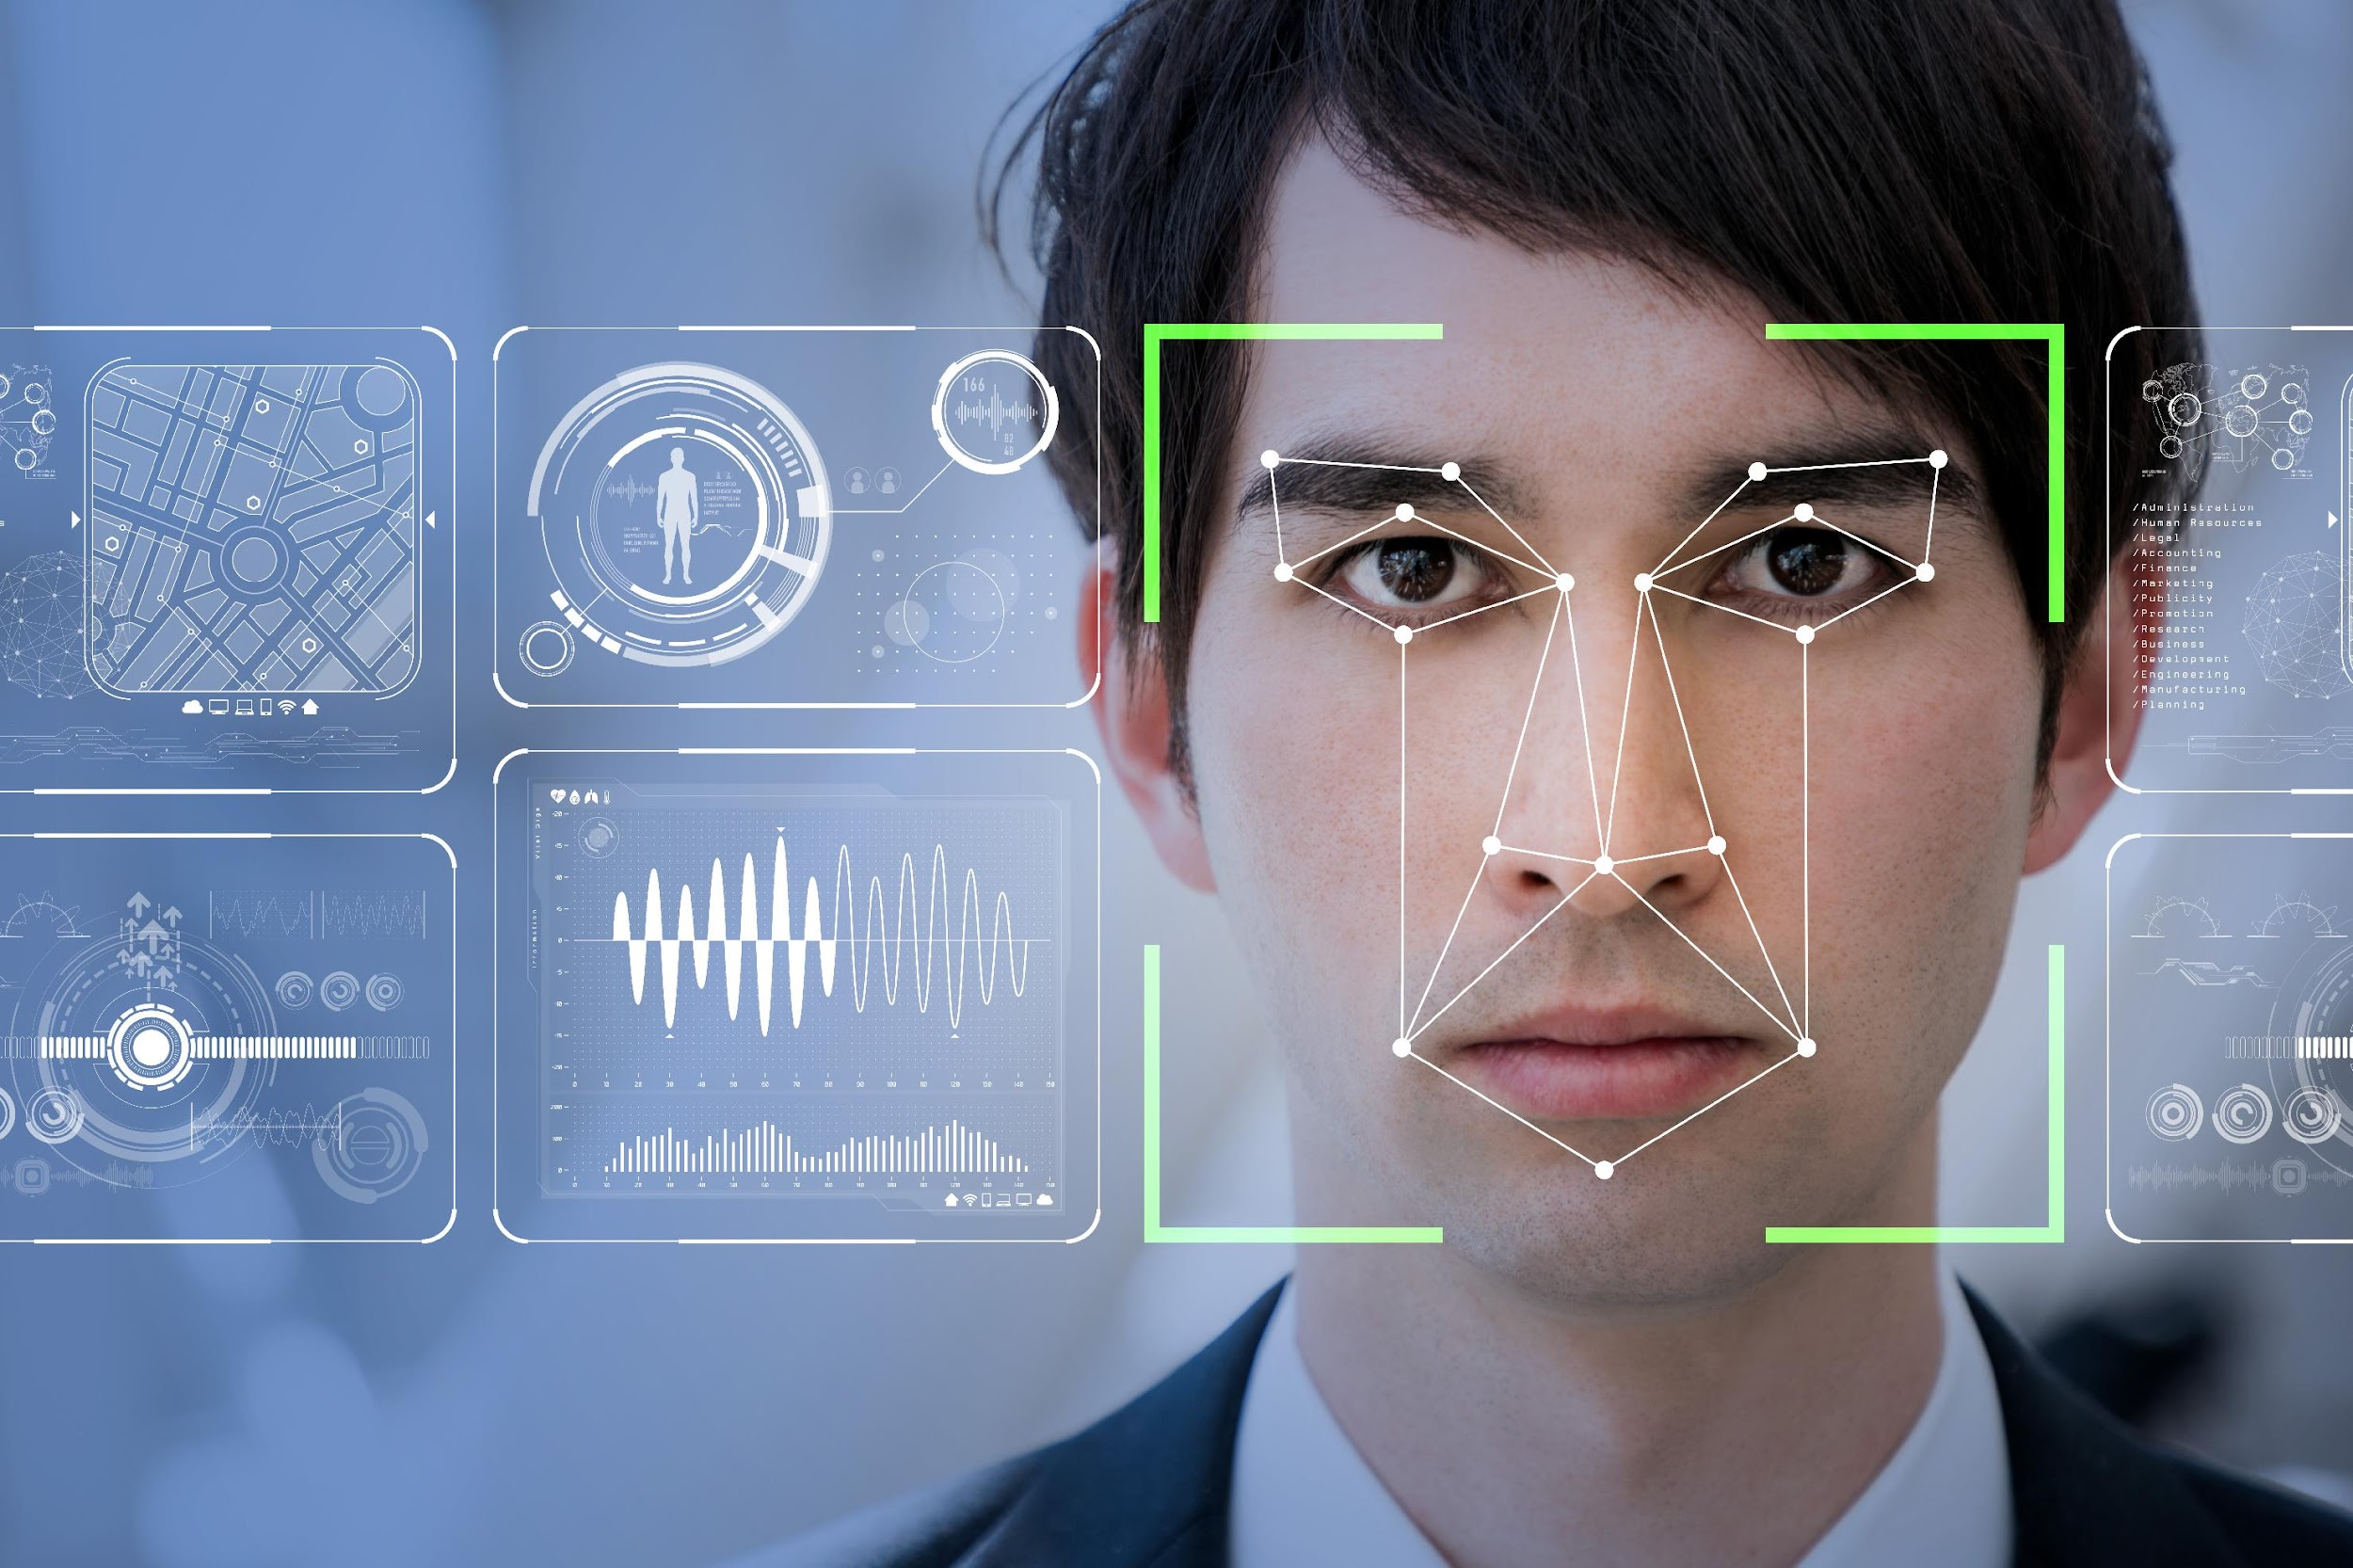
FACIAL ANALYSIS FOR EMOTION DETECTION

Slide 3

TEAM MEMBERS
AJIN DEV.D
ADARSH.G
KRIPA ANNA KUNJUMON

Slide 4
INTRODUCTION
Humans possess a natural ability to understand the face expressions. In real life, humans express the emotions on their face to show their psychological state and disposition at a time and during their interactions with other people.
Automatic emotion detection using facial expressions recognition is now a main area of interest within various fields such as computer science, medicine, and psychology. HCI* research communities also use automated facial expression recognition system for better results. Various feature extraction techniques have been developed for recognition of expressions from static images as well as real time videos.Facial Emotion Recognition is a technology used for analysing sentiments by different sources such as pictures and videos.
Facial analysis using deep learning has become a powerful tool for a variety of use cases from capturing emotions of customer to screening candidates when applicants are very large in numbers for positions such as sales staffs on supermarket shop floors. In this project we have built prototype application for facial emotion detection using deep learning models.
*Human–computer interaction

Slide 5
Why Emotion Detection?
Provision of personalized services
Analyse emotions to display personalized messages wise in smart environments
Provide personalized recommendations, e.g. on musical selection or cultural material.
Analyse facial expressions to predict reaction to movies.
Education
Monitor students attention.
Detect emotional reaction of users to an educative program and adapt the learning path.
Design affective tutoring system .
Public safety
Lie detectors.
Predictive screening of public spaces to identify emotions triggering potential terrorism threat.
Analysing footage from crime scenes to indicate potential motives in a crime.
Customer behaviour analysis and advertising
Analyse customers emotions while shopping focused on either goods or their arrangement within the shop.
Healthcare
Suicide prevention.
Detect depression in elderly people.
Observe patient’s conditions during treatment.
Crime detection
Deploy fraud prevention strategies
Employment
Monitor moods and attention of employees

Slide 6






Some Companies that make use of emotion detection...
The emotion detection technology of this device could help autistic children understand emotions and engage in more direct ways with those around them.
Facial emotion recognition technology and AI to assess if new programs will be popular
Hire Vue's AI-based technology to screen potential candidates
Uses emotion-sensing
technology to learn
opinion on a completed
project
Uses Affectiva's software to test public reaction advertisement for its cereal.
Records client’s emotions using Microsoft Emotions API

Slide 7
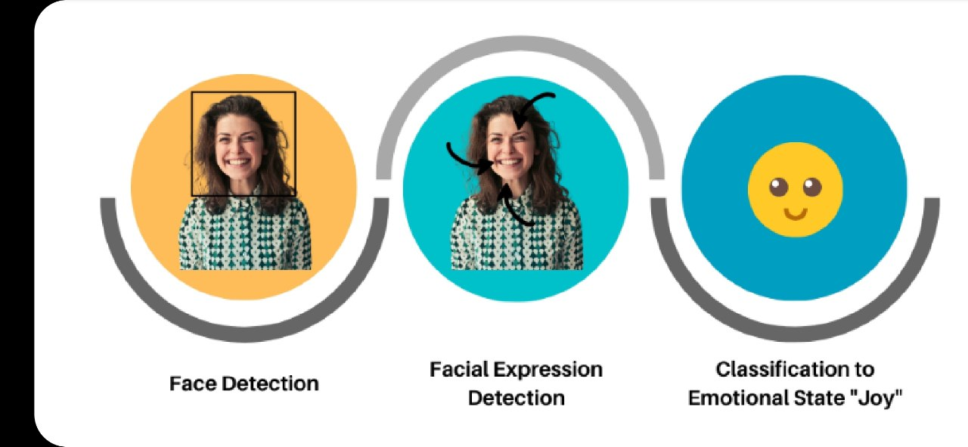
Steps of Facial Emotion Recognition

Slide 8
STEPS:
Data collection
Data preprocessing
Image Augmentation
Create the convolution base
Add Dense layers on top
Compile and train the model
Evaluate the model

Slide 9

FACIAL EXPRESSION RECOGNITION

Slide 10
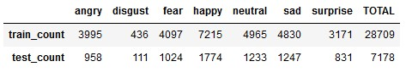
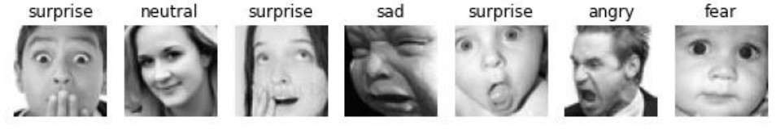
Data Set
Dataset used to train and test model is publicly available FER2013 data set.
The data consists of 48x48 pixel grayscale images of faces.
The faces are divided into seven categories according to the facial expressions. (0=Angry, 1-Disgust, 2-Fear, 3-Happy, 4-Sad, 5-Neutral, 6=Surprise).
The dataset consists of 35887 images, of which 28709 labeled images are included in the train set and the remaining 7178 images are included in the test set.
.

Slide 11
Pre-processing & Image Data Augmentation
Keras ImageDataGenerator was used for the preprocessing and Augmentation.
This process includes cropping and scaling of the images.
For Data cleaning purposes, all image target sizes were resized to a dimension of 48x48.
Converted the images into a grayscale color channel, and preprocessed in a batch size of 64.
One-hot encoding is used to convert class labels to numeric features.
For efficient generalization and optimized model performance, Augmentation was used to expand the size of the training dataset by creating several modified variations of the images using the ImageDataGenerator Class in Keras.

Slide 12
Model & Training
Keras library in python is used for training the images.
Splitted the dataset into training batch & a validation batch, using Data Augmentation techniques.
Sequential model was implemented to define the flow of the CNN.
Added 4 Conv2d layer blocks in this model and 64, 128, 256, 512 filters respectively.
Conv2d layers followed by batch normalization to prevent gradient vanishing and exploding, and max pooling to reduce the spatial dimension of the image.
Layers encompass rectified linear units (ReLU) activation function.
Dropouts were used at several layers of the CNN to prevent the overfitting.
The outputs from these feature extraction models are flattened into vectors, and transmitted to fully connected layers for evaluation before a final output layer permits classification.
Adam Optimizer with learning rate of 0.0001 used to improve the classification efficiency of the model.
Also used categorical cross-entropy loss function.
We use the model checkpoint in training, to save the current state of the model.

Slide 13

Emotion Detection Model Structure
Sequential Model
Batch Normalization
MaxPooling2D
Dropout
Batch Normalization
MaxPooling2D
Dropout
Batch Normalization
MaxPooling2D
Dropout
Batch Normalization
MaxPooling2D
Dropout
Convolution
+
ReLu
Convolution
+
ReLu
Convolution
+
ReLu
Convolution
+
ReLu
Input
[___________________
Feature Maps
_____________________________]
F
l
a
t
t
e
n
Happy
0.2
Output
+
softmax
Surprise
0.7
Sad
0.1
Dropout
Dropout
Dropout
Probabilistic Distribution
[_____________
Dense+ReLU
Classification
_________]

Slide 14
Model Summary
Model: "sequential"
__________________________________________________________________________
Layer (type) Output Shape Param #
=================================================================
conv2d (Conv2D) (None, 46, 46, 64) 640
conv2d_1 (Conv2D) (None, 46, 46, 64) 36928
batch_normalization (BatchN (None, 46, 46, 64) 256
ormalization)
max_pooling2d (MaxPooling2D (None, 23, 23, 64) 0
)
dropout (Dropout) (None, 23, 23, 64) 0
conv2d_2 (Conv2D) (None, 23, 23, 128) 73856
batch_normalization_1 (Batc (None, 23, 23, 128) 512
hNormalization)
conv2d_3 (Conv2D) (None, 23, 23, 128) 147584
batch_normalization_2 (Batc (None, 23, 23, 128) 512
hNormalization)
max_pooling2d_1 (MaxPooling (None, 11, 11, 128) 0
2D)
dropout_1 (Dropout) (None, 11, 11, 128) 0
conv2d_4 (Conv2D) (None, 11, 11, 256) 295168
batch_normalization_3 (Batc (None, 11, 11, 256) 1024
hNormalization)
conv2d_5 (Conv2D) (None, 11, 11, 256) 590080
batch_normalization_4 (Batc (None, 11, 11, 256) 1024
hNormalization)
max_pooling2d_2 (MaxPooling 2D) (None, 5, 5, 256) 0
dropout_2 (Dropout) (None, 5, 5, 256) 0
conv2d_6 (Conv2D) (None, 5, 5, 512) 1180160
batch_normalization_5 (None, 5, 5, 512) 2048
(Batc hNormalization)
conv2d_7 (Conv2D) (None, 5, 5, 512) 2359808
batch_normalization_6 (Batc ( (None, 5, 5, 512) 2048
hNormalization)
max_pooling2d_3 (MaxPooling (None, 2, 2, 512) 0
2D)
dropout_3 (Dropout) (None, 2, 2, 512) 0
flatten (Flatten) (None, 2048) 0
dense (Dense) (None, 512) 1049088
dropout_4 (Dropout) (None, 512) 0
dense_1 (Dense) (None, 256) 131328
dropout_5 (Dropout) (None, 256) 0
dense_2 (Dense) (None, 128) 32896
dropout_6 (Dropout) (None, 128) 0
dense_3 (Dense) (None, 7) 903
=================================================================
Total params: 5,905,863
Trainable params: 5,902,151
Non-trainable params: 3,712
_________________________________________________________________

Slide 15
Hyperparameters and their corresponding values
Batch size | 64
Number of epochs | 125
Optimizer | Adam
Learning rate (lr) | 0.0001
FC1 neurons | 512
FC2 neurons | 256
FC3 neurons | 128
Dropout | 0.4, 0.5
Convolution kernel size | 3x3
MaxPooling kernel size | 2x2
MaxPooling strides | 2x2
Kernel_regularizer | L2(0.01)

Slide 16
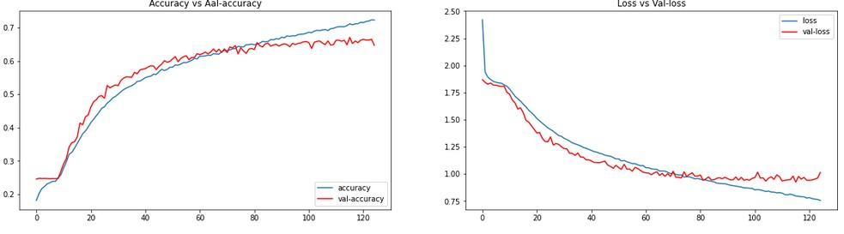
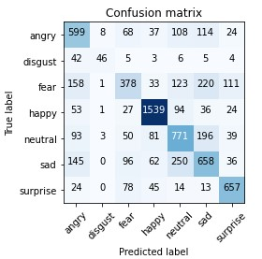
Performance
The model gives 65-67% accuracy on validation set while training the model.

Slide 17

FACE DETECTION

Slide 18
Face Detection Image pre-processing And Augmentation
We have collected 250 Images with face and faceless from pexels.com and unsplash.com.
Annotation process has been done by the tool labelme.
The labels are in the form of json files and coordinates are pascal_voc format.
Json library is used to load the json files.
Manually moved the unaugmented data into train, test and validation partition.
The annotated coordinates are in the form of pascal_voc. For unscaled images pascal_voc hasn’t adjusted for the size of the image. So pascal_voc is converted to albumentations format to get normalize values.
The faceless images classified as class 0, and also it’s coordinates assigned to [0, 0, 0, 0]. And with face images have been assigned to class 1.
The Images have been augmented with Albumentation library to get sufficient amount of data.
Then resized the images to 120x120 pixels, and also scaled the images.
Images and labels were then combined.

Slide 19
Face Detection Dataset Architecture
IMAGES(250)
Training Images
(175)
Test Images
(38)
Validation Images
(37)
Image Augmentation
Training Images
(20280)
Test Images
(4560)
Validation Images
(4320)

Slide 20
Model & Training
The Functional API is used to build the model.
The double head method is used to train the model, which has two fully connected heads. One for binary classification and one for bounding box regression.
The VGG16 without 3 fully connected layers on top of the network model is used as the base architecture.
The input layer (120, 120, 3) is connected to vgg16 and the output of vgg16 is connected to two separate Global Maxpooling layers. Global Maxpooling layers reduce the dimensionality of the feature maps output of the VGG16.
Each Global Maxpooling layers connect to dense layers. The dense layer includes ReLU activation function and 2048 nodes.
One dense layer ends at 1 node with sigmoid activation function for classification and another ends at 4 nodes with sigmoid for regression.

Slide 21
Model & Training cont…
Adam Optimizer with a learning rate of 0.0001, and lr_decay used to slow down learning.
We use Localization Loss for the Bounding Box regression and classification loss as Binary Cross entropy.
Compiled the model with optimizer, class loss and localization loss.
We trained the model with 40 epochs.
After checking the performance of the model, it has been saved as h5 format.

Slide 22
Facedetector Model Architecture
input_2 (InputLayer)
vgg16 (Functional API)
classification
regression
Global_max_pooling2d
(GlobalMaxPooling2D)
Global_max_pooling2d_1
(GlobalMaxPooling2D)
dense_1 (Dense)
dense (Dense)
dense_2 (Dense)
dense_3 (Dense)

Slide 23
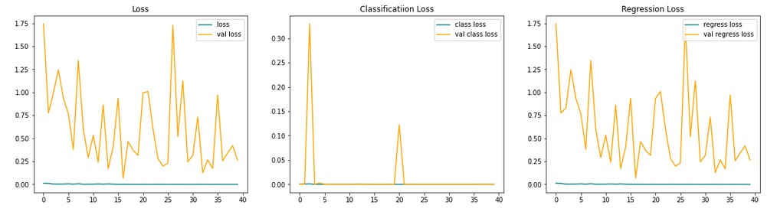
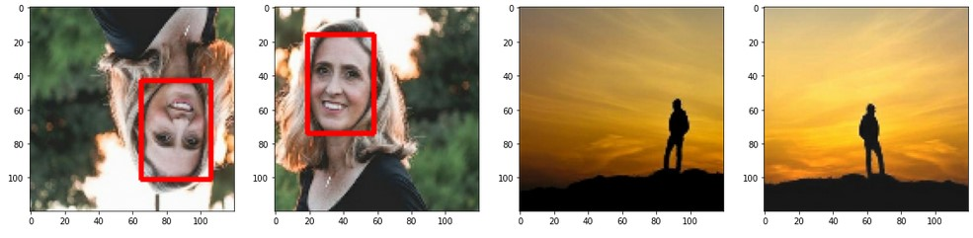
Performance and Prediction

Slide 24
Real Time Emotion Analysis
OpenCV and Keras functions have been used.
Models were loaded with keras load model function.
Webcam video frames stored in a object.
The image frames converted to grayscale and resized with numpy
This resized image is sent to the face detection model.The detected faces then fed to the emotion detection model.
The max argument is the output .
A rectangle is drawn around the facial regions and the current state of emotion and percentage of accuracy is formatted above the rectangle box.
The application is usable through web front end using Flask.
The detected emotions, time, accuracy and frames save to MongoDB Atlas database.
You can analyze this data as your on consideration.

Slide 25





Capture video from camera using OpenCV
Frames are converted to grayscale and resized.
Real Time Emotion Analysis
Detect faces in frames using the facetector model.
Detects facial emotions using the emotion detection model and also returns the accuracy percentage.
The data is uploaded to mongoDB Atlas DBaaS.

Slide 26
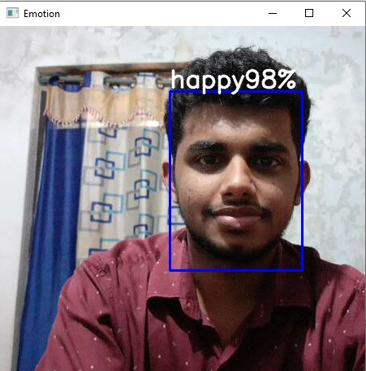
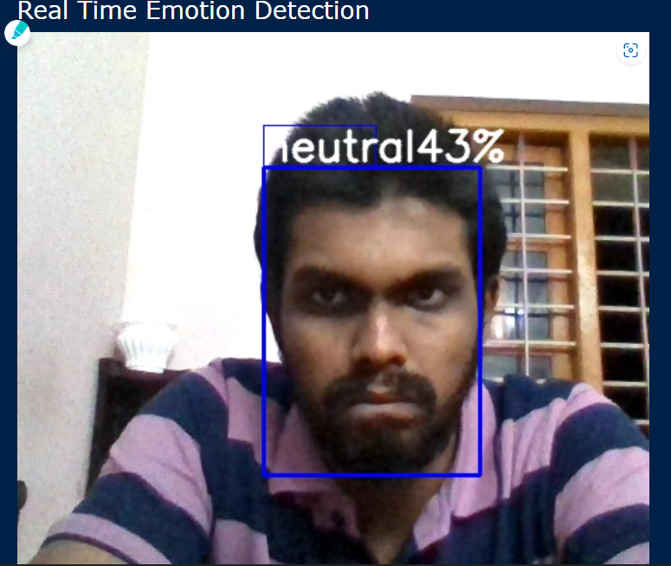
Result
We have already used 2 min video from our webcam for emotion analysis. The analyzed chart is given below.

Slide 27
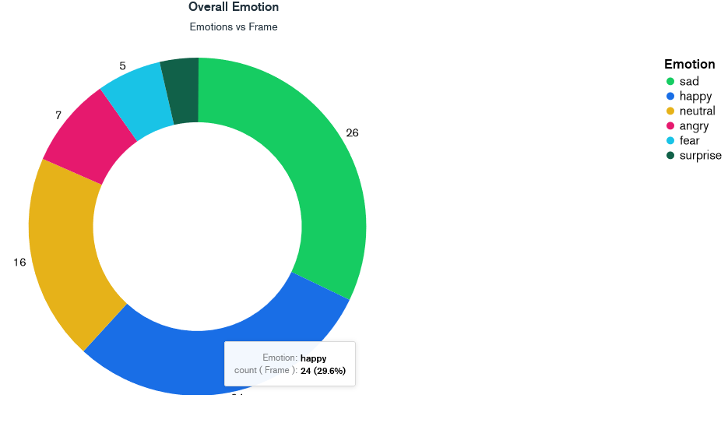
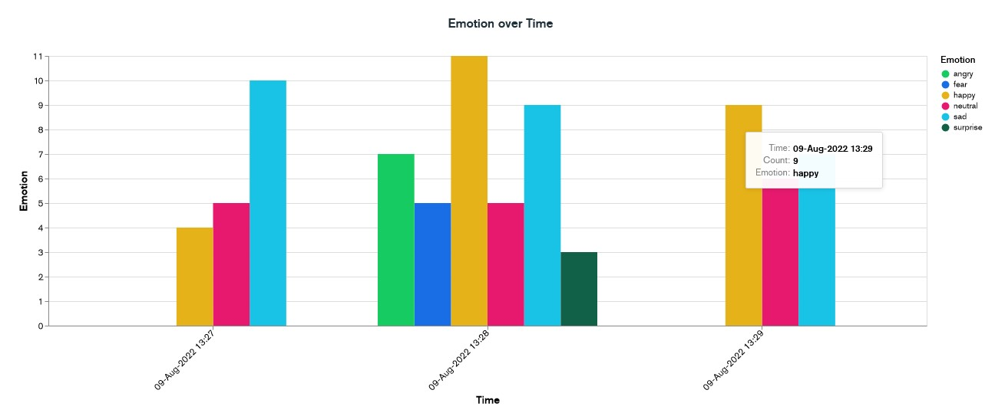
FACIAL ANALYSIS

Slide 28
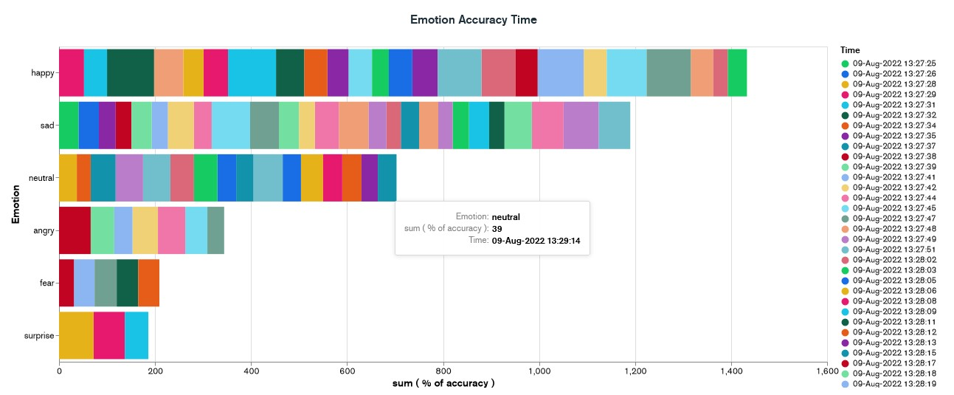
References

Slide 29
Reference
1 . Shopping for emotion
Anton Forsberg (Umea University )
2. arXiv & Google Scholar articles
SSD: Single Shot MultiBox Detector (2015)
Group-level Emotion Recognition using Transfer Learning from Face Identification (2017)
DSFD: Dual Shot Face Detector (2019)
Hybrid Facial Expression Recognition Model for Real-Time Emotion Classification and Prediction (2022)
3. Stack Overflow
4. Online articles from commercial sites on emotion detection.

Slide 30
~Thank You~

